Slide 1

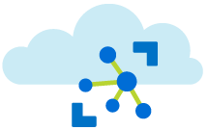



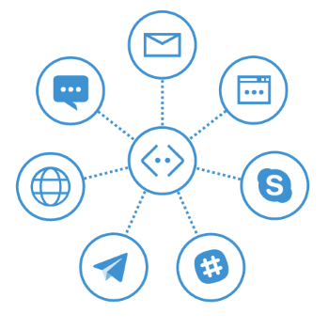
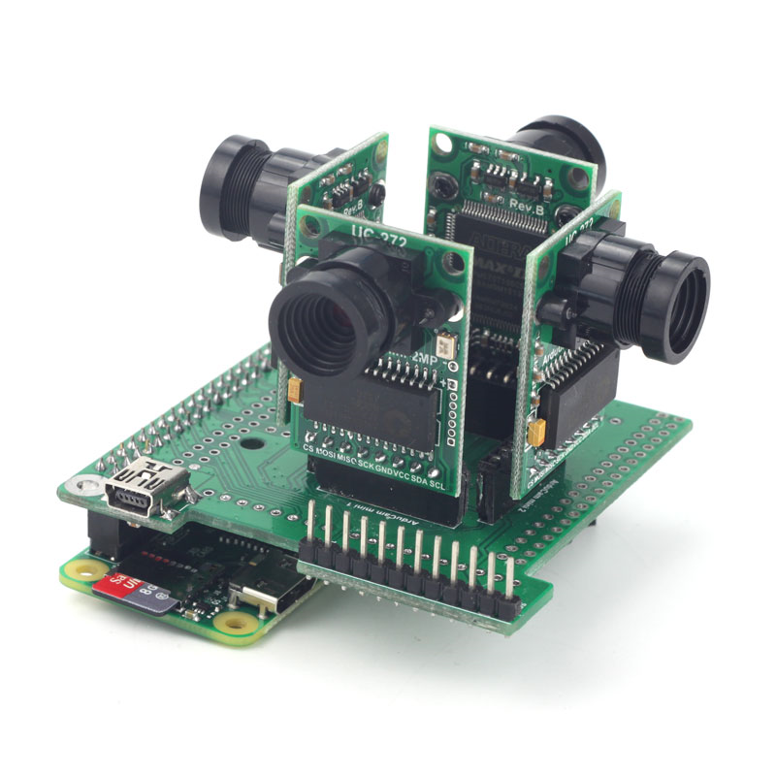
Cat Finder Phase 1
Stray Cat Collection
Processing
Cat Collection
Bot user id
Suburb (long/Lat)
Name, Gender, Breed,
Other distinguishing marks
Image Url, Timestamp, Found
Missing App Service Cat Bot
Azure IoT Hub
Stray Cat Camera
Stray Cat Collection
Camera long/Lat
Timestamp
Image Url
Bot user show stray by area
Report Missing
Found Missing
Show Missing
Bot user report stray

Slide 2


Cat Finder Phase 2
Snapped Cats
Processing
Cat Matching &
notification
HTTP POST Found Cat
Missing App Service Cat Bot
Azure IoT Hub
Cat Repository
Bot user id
Suburb (long/Lat)
Name, Gender, Breed,
Other distinguishing marks
Image Url, Timestamp, Found
Cat Matching
TensorFlow
Cat Camera
Snapped Cats
Camera long/Lat
Timestamp
Image Url
Report Missing
Found Missing
Show Missing

Slide 3

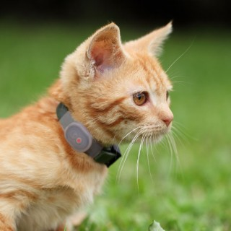
Cat Tracker Phase 3 (Lora Tags)
Things Network to IoT Hub Http Azure Function
Tracked Cat Collection
Suburb (long/Lat),
Timestamp
Cat Tracker Bot
Azure IoT Hub
LoraWan
Cat GeoLoc

